Slide 1


Evaluation of Heart Attack Risk Factors
Jafar Vohra: Team Leader / Machine Learning Engineer
Moureen Lukoye Nampijja: Data Scientist / Data Visualizer
Smit Patel: App Developer / Data Analyst
Mahesh Potu: Researcher / Storyteller

Slide 2
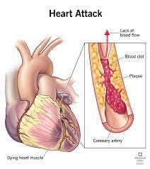
Business Understanding
Heart disease is the leading cause of death in the United States.
In the United States, someone has a heart attack every 40 seconds.
Every year, about 805,000 people in the United States have a heart attack.
605,000 are a first heart attack
200,000 happen to people who have already had a heart attack
https://www.cdc.gov/heartdisease/facts.htm

Slide 3

The Business Problems
How can we identify the most influential factors that put cardiologist patients at a higher risk of a heart attack?
How can we provide individualized recommendations to cardiologist patients so that they can reduce their risk of heart attacks?

Slide 4

Our Goals
Utilize patient data to predict the heart attack risk level
Observe from patient data which factors contribute the most to the predictions
Provide tips to patients to mitigate heart attack risk factors based on the most important features

Slide 5
Data Understanding
Patient ID: Unique identifier for each patient
Age
Sex: Male/Female
Cholesterol: (mg/dL)
Blood Pressure: Systolic/Diastolic (mm Hg)
Heart Rate: (BPM)
Diabetes: (1: Yes, 0: No)
Family History: (1: Yes, 0: No)
Smoking: (1: Smoker, 0: Non-smoker)
Obesity: (1: Obese, 0: Not obese)
Alcohol Consumption: (1: Yes, 0: No)
Exercise Hours Per Week
Diet: Healthy/Average/Unhealthy
Previous Heart Problems: (1: Yes, 0: No)
Medication Use: (1: Yes, 0: No)
Stress Level: (1-10)
Sedentary Hours Per Day
Income
BMI: Body Mass Index
Triglycerides: (mg/dL)
Physical Activity Days Per Week
Sleep Hours Per Day
Country
Continent
Hemisphere
Heart Attack Risk: (1: Yes, 0: No)
5

Slide 6
Data Preparation and Exploration
Check
Check for missing values in records and duplicated values
Create
Create pie charts and distribution plots to understand features
Encode
Encode the categorical variables from textual data to numerical data
Engineer
Engineer new features from existing ones to capture underlying trends in the data
Observe
Observe linear relationships between features via correlation heatmap

Slide 7
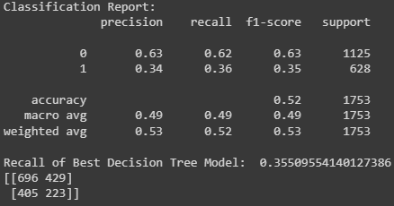
Modeling Process
Select the relevant features
Split the data into train and test sets with an 80/20 split
Fit the training data to 10 different models
Evaluate the recall of each model while observing the confusion matrix
Tune the hyperparameters of the best performing model
Observe the importance of the features in the best model

Slide 8
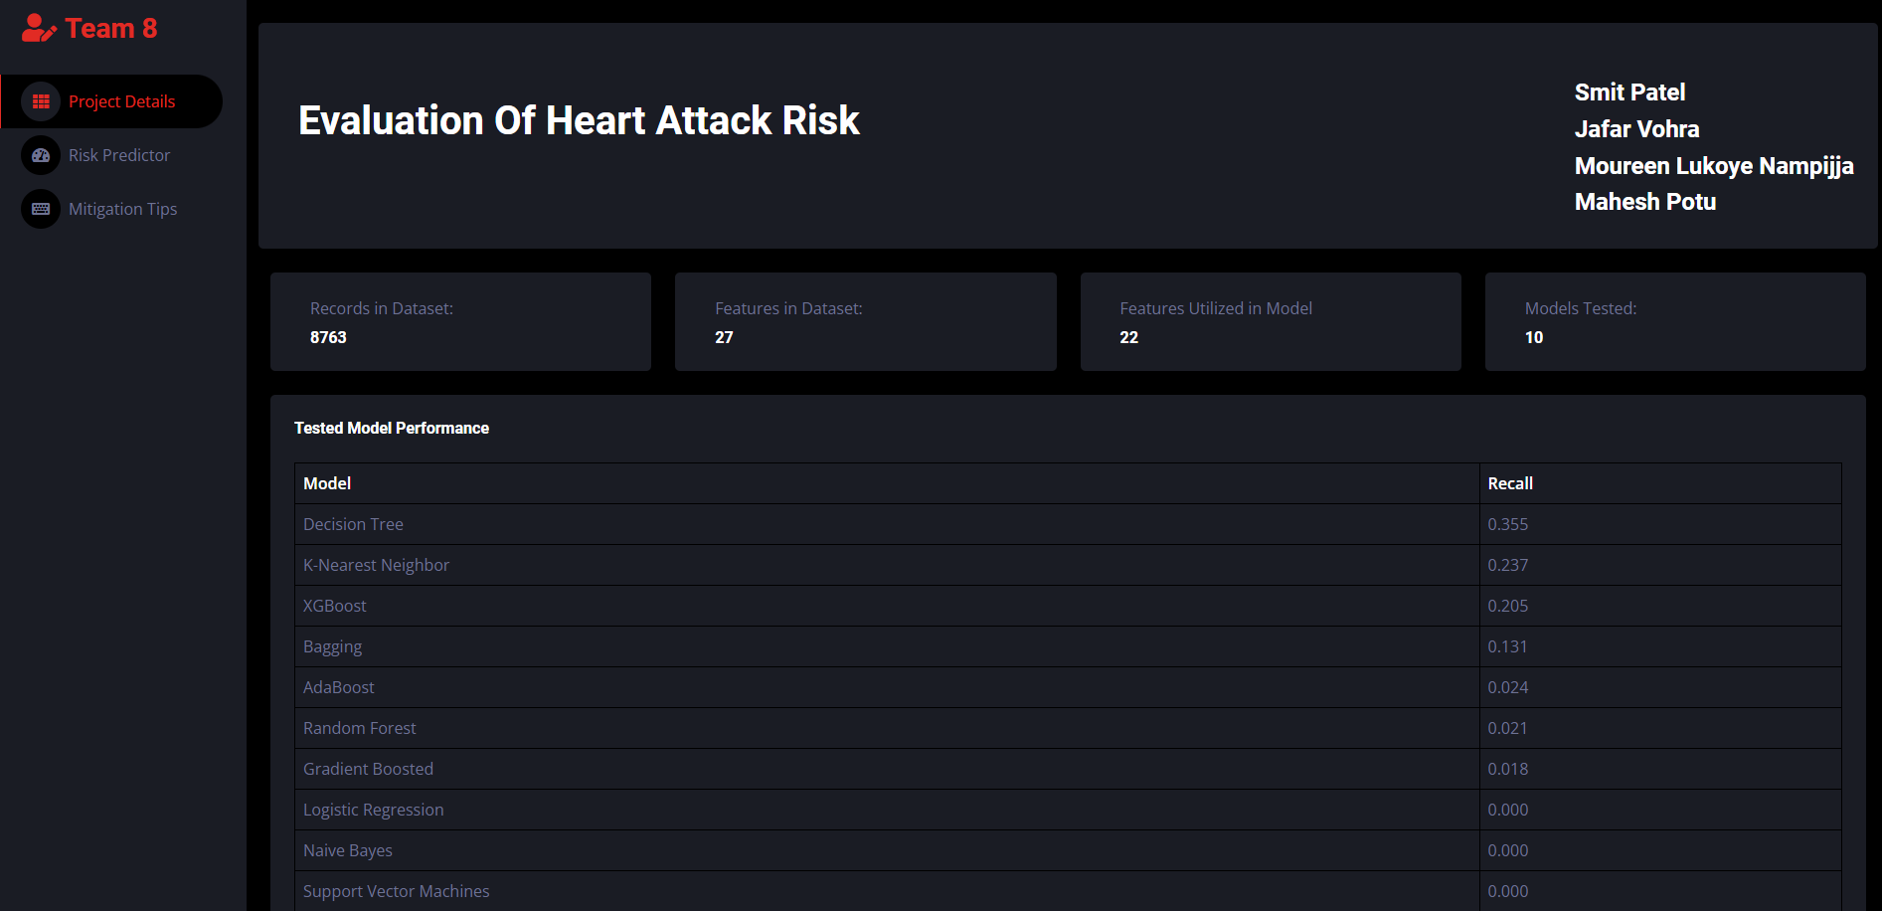

Slide 9
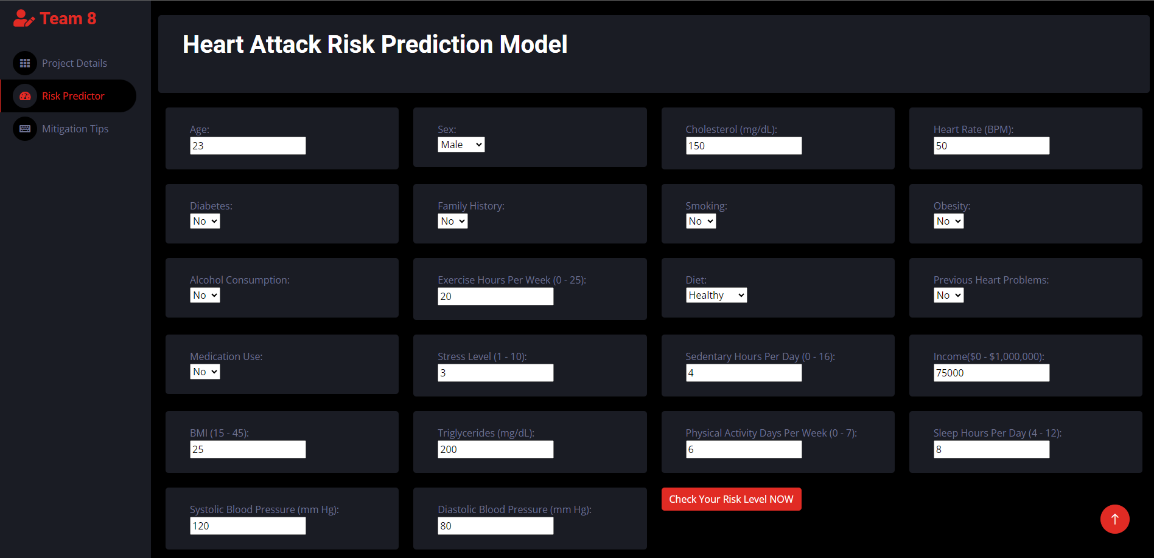

Slide 10
